Slide 1

Project PicMe
Version 1.12
Justin Storms, Andrian Stepanyuk, Wyatt Stohr
Central Washington University
CS380 - Final Project
Notes:
Quick introduction to the project and our group.

Slide 2
Meet the team!
Justin Storms
Lead coordinator & Full-stack developer
Andrian Stepanyuk
UI designer & Front-end developer
Wyatt Stohr
Back-end developer & Database engineer
Notes:
Talk about your position, what you were tasked to do, and what you accomplished in the project.

Slide 3
Libraries, Languages, and Resources
Java
IntelliJ
SceneBuilder
JavaFX
JUnit
SQL
MySQL
Apache
Spring Framework
Lombok
Gson
JSON
Notes:
Briefly describe each of our resources and spend more time on the resources that were more significant.

Slide 4
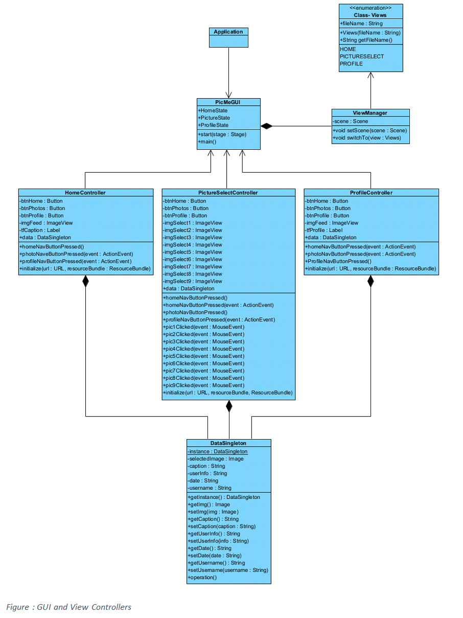
Project Description
Front-end
The front-end uses JavaFX to build the GUI. Java controllers are linked to FXML scenes to handle user inputs. ViewManager class controls changing scenes. DataSingleton class allows for data to be passed between scenes.
Notes:
Speak about front-end functionality and development. Speak about things that went well and things that didn’t.

Slide 5
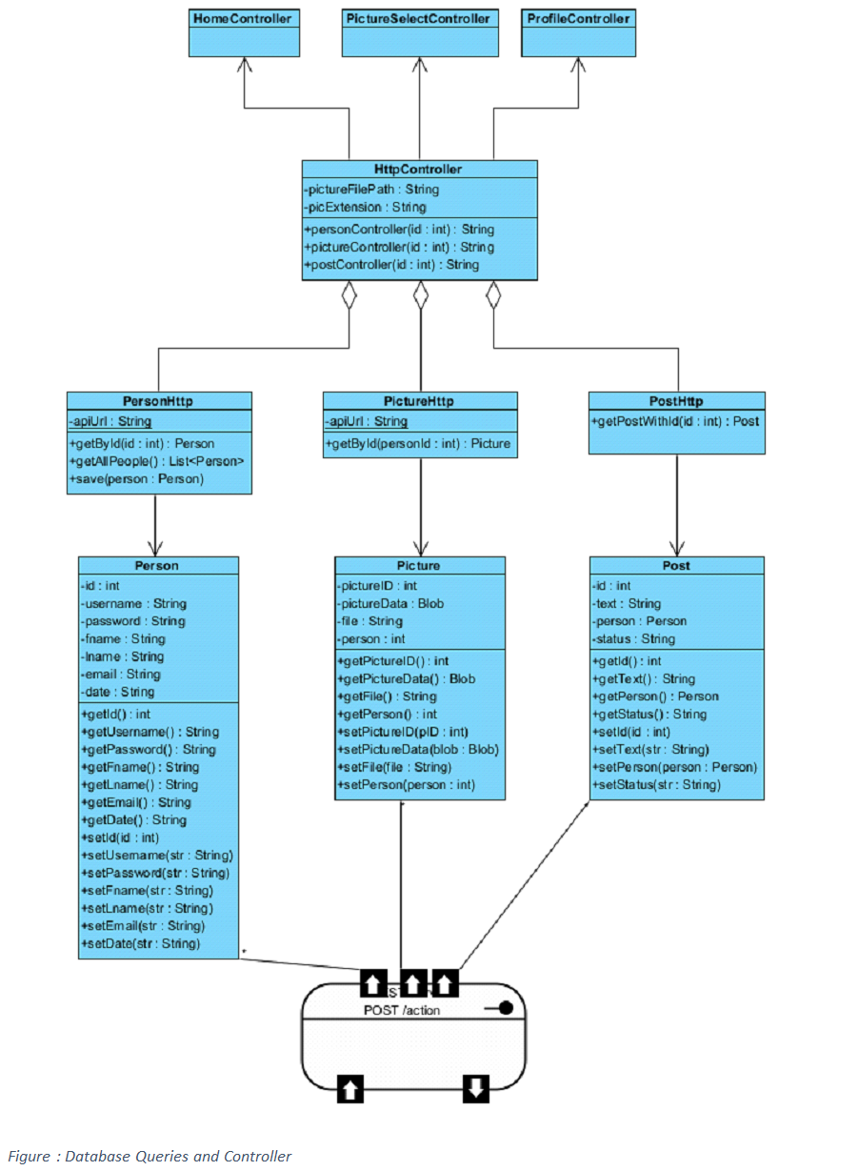
Project Description
Back-end
The back-end is Spring Boot REST API. It connects a MySQL database to the front-end GUI via HTTP requests.
Notes:
Speak about back-end functionality and development. Speak about things that went well and things that didn’t.

Slide 6
Project PicMe Demo
Notes:
Demo the project.

Slide 7
Possible Feature Additions
Login Functionality
Signup Functionality
Post/Picture/Comment Upload
Comments
User Settings
Password Management
Friends List Management
Friend Profile Navigation
Administrator Database Management
Security Measures
Search Users
Like Posts
Notes:
After project demo, speak about all the possible feature additions that were initially planned or could be added after the fact.

Slide 8
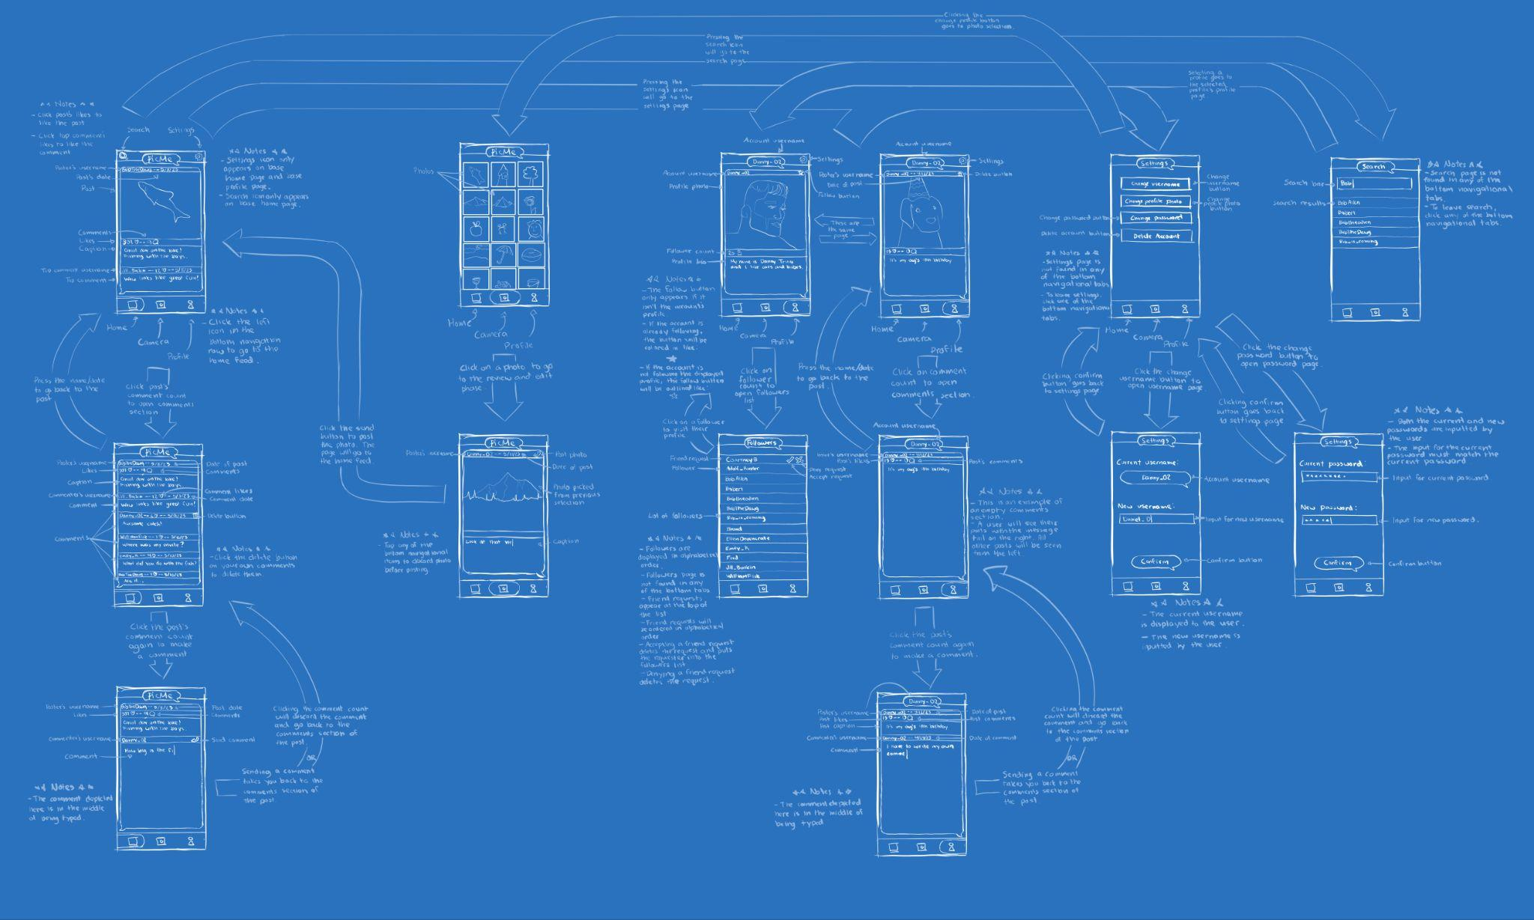
Notes:
Talk about the initial vision we had for the project.

